Slide 1



Brought to you by
Shifting Trends
Presented by ITR Economics CEO and Chief Economist Brian Beaulieu
Notes:
Proofed EZ 12.17.21

Slide 2
2022 Forecast Results
 | Duration | Accuracy
US GDP | 18 | 98.9%
US Ind. Production | 18 | 98.9%
Europe Ind. Production | 23 | 99.6%
Canada Ind. Production | 24 | 99.5%
China Ind. Production | 16 | 98.5%
Retail Sales | 13 | 98.0%
Housing - Single Family | 17 | 84.8%
Employment-Private Sector | 13 | 98.7%
ITR Economics provides the best economic intelligence to reduce
risk and drive practical and profitable business decisions.
Notes:
March 8 2023 BB – NO ASTERISK!!

Slide 3
Arizona Growing Faster Since The Great Recession
Source: BEA
US and Arizona Gross Domestic Product
Quarterly Data Trends
Notes:
Charts-State\Arizona\Arizona SQL Charts AZ3MMAGDP 3/27/23
GDPCON, GDP-AZ

Slide 4
County Almost Keeping Pace With All of AZ
Source: BEA
Arizona to Yavapai GDP
Quarterly Data Trends
Notes:
W:\ITRDATA\PowerPoint Charts\Charts - State\Arizona\Arizona SQL Charts.xlsx AZ Yavapai GDP 3/27/2023
GDP – AZ
Yavapai county data is not on the database.

Slide 5
Inverse Yield Curve Fallout Ahead
Source: BEA
US Real Gross Domestic Product
Quarterly Data Trends: Trillions of Chained 2012 Dollars
Notes:
Charts from SQL\3MMA Comp\3MMA Comp 4 SQL Charts GDP GDPCON CANGDP 3/23/2023
NOTE: Using forecast that is NOT in SQL, sent by BB

Slide 6
A Powerful Management Tool • Rates-of-Change
Raw
3MMT
3/12
12MMT
12/12
3MMT
16.7
17.6
17.8
18.0
18.3
18.3
18.6
18.9
19.2
19.0
18.6
19.5
20.3
21.5
21.6
21.4
21.4
21.0
21.3
20.9
20.7
20.1
3/12
21.7%
21.7%
21.0%
19.0%
17.3%
14.9%
14.7%
11.0%
7.9%
6.2%
12MMT
72.2
73.4
74.7
75.8
77.2
78.5
79.2
80.3
81.2
81.9
82.4
82.7
83.1
12/12
21.5%
21.0%
20.2%
19.5%
17.9%
16.4%
15.2%
Mar-21 | 4.803
Apr-21 | 6.035
May-21 | 5.850
Jun-21 | 5.756
Jul-21 | 6.216
Aug-21 | 5.982
Sep-21 | 6.075
Oct-21 | 6.208
Nov-21 | 6.279
Dec-21 | 6.366
Jan-22 | 6.524
Feb-22 | 6.063
Mar-22 | 6.001
Apr-22 | 7.406
May-22 | 6.904
Jun-22 | 7.162
Jul-22 | 7.501
Aug-22 | 6.697
Sep-22 | 7.228
Oct-22 | 7.056
Nov-22 | 7.014
Dec-22 | 6.857
Jan-23 | 6.818
Feb-23 | 6.458
3/12
12/12
Based on data from a consecutive 3-month period compared to one year earlier.
Anticipates shifts in business cycle trends.
Based on data from a consecutive 12-month period compared to one year earlier.
Defines the business cycle.
Notes:
**NOTE – COPY AND PASTE THIS ONE FROM MASTER G/DO NO CHANGE THE TEMPLATE
W:\ITRDATA\PowerPoint Charts\Charts - Special\Data Prep Rates-of-Change.xlsx Uses WTTOT 3/7/2023
One DP only in final %
Text from, “Projecting When Business Cycles Will Change. An ITR Economics Technical Reference Manual” pg 8.
Wholesale Trade

Slide 7

Inverse Yield Curve Induced Recession
Source: FRB
US Industrial Production Index
2017 = 100
Notes:
W:\ITRDATA\PowerPoint Charts\Master SQL Charts TIPRONSA SOC frcst 3/23/2023 June 2021 forecast
FRB

Slide 8


Brought to you by
Global Forces

Slide 9
Percent of World GDP by Country
Source: IMF, *ROW: 36% are IMF Estimated Figures
Iran
*Total World GDP:
$97.1 Trillion US $
Notes:
Update procedure: W:\Data\DM\Procedures\Presentations\Special Chart Updates\GDP (world) Pie Chart.docx
Misc Imp Charts/IMF Global GDP WorldGDPChart 10/13/22 *update in Apr 2023 2021 DATA

Slide 10
China is Weakening
Sources: China National
Bureau of Statistics, FRB
China Industrial Production Index to US Industrial Production Index
3/12 Rates-of-Change
Notes:
W:\ITRDATA\PowerPoint Charts\Charts - Reserve\Comps\CHINAIP Comp NSQL.xlsx CHINAIP TIPRONSA 3/24/2023

Slide 11
Global Weakness
Source: CPB Netherlands Bureau
For Economic Policy Analysis
World Industrial Production Index
2010 = 100
Notes:
W:\ITRDATA\PowerPoint Charts\Charts from SQL\SOC MMA\SOC MMA 4 SQL Charts.xlsx WORLDIP SOC 3/27/2023

Slide 12
Less Supply Chain Pressure
Sources: FRBNY, ISM
Global Supply Chain Pressure Index to US Purchasing Managers Index
Rates-of-Change
Notes:
W:\ITRDATA\PowerPoint Charts\Master SQL Charts GSCPX PMI 1.12 3/17/2023
PMI

Slide 13

EU is the #1 Source
Source: BEA
Foreign Direct Investment Into the US
 | Billions $
Total | $301.9
European Union | 107.2
United Kingdom | 52.2
Canada | 51.3
Germany | 27.0
Netherlands | 26.9
Sweden | 14.4
Switzerland | 14.0
Luxembourg | 6.714
South Korea | 5.195
Mexico | 5.170
Denmark | 3.544
Israel | 0.749
Annual Data Trend
Notes:
Charts-Special\FDI Charts Updated.xlsx 12MMT Table 3/27/2023 China ranks dead last at $ -1.369
FDIUS, EU-FDIUS, CANFDIUS, NTHFDIUS, IREFDIUS, UKFDIUS, GERFDIUS, SWTFDIUS, FRFDIUS, MEXFDIUS, ITLFDIUS, SPFDIUS, BRZFDIUS

Slide 14

EU is the #1 Destination of Outbound FDI
Source: BEA
US Direct Investment Abroad
Top 10 Recipients | Billions $
Total | $373.0
United Kingdom | 85.8
Netherlands | 63.0
Ireland | 47.9
Canada | 42.2
Singapore | 37.1
Bermuda | 18.8
UK Islands, Caribbean | 17.8
Mexico | 16.7
Germany | 12.9
China | 9.153
Annual Data Trend
EU Total: $ 114.9 bn
Notes:
Charts-Special\FDI Charts Updated.xlsx 12MMT Table (DIA) 3/27/2023 China ranks #10 at $9.2 bn
No DOS Codes

Slide 15
Global Summary
China is becoming more of a problem going forward with mounting risks
Develop a strategy to capitalize on the nationalism trend
Lessen your reliance on China
Russia is a hollowed-out version of its former self
Nationalism is the long-term play
Notes:
Jan 2023

Slide 16

Brought to you by
Inflation &
Interest Rates
Notes:
2022

Slide 17
A Lot of Damage to Correct For
Sources: FRB, US Department of the Treasury
US M2 Money Supply (deflated) to US Total Public Debt Outstanding
Data Trends
Notes:
W:\ITRDATA\PowerPoint Charts\Charts from SQL\Raw Comp\Raw Comp 2 NSQL Charts.xlsx M2D FDDBTOUTSTDT 3/29/2023

Slide 18
2009 Tipping Point
Sources: FRB, US Treasury
US Industrial Production Index to US Total Public Debt Outstanding
Data Trends
Notes:
\Charts from SQL\12MMA Comp\12MMA Comp 6 SQL Charts.xlsx TIPROHNSA FDDBTOUTSTDT 3/20/2023

Slide 19
Disinflation in Food Prices is Alleviating Some CPI Pressure
Source: BLS
US Consumer Price Index to US Intermediate Food Materials Producer Price Index
3/12 Rates-of-Change
Food
Notes:
W:\ITRDATA\PowerPoint Charts\Charts - Reserve\Comps\CPIUA Comp NSQL.xlsx CPIUA IMFDPI 3/20/2023

Slide 20
Energy is Added to the Disinflation List
Source: BLS
US Consumer Price Index to US Energy Consumer Price Index
Rates-of-Change
Notes:
W:\ITRDATA\PowerPoint Charts\Charts - Reserve\Comps\CPIUA Comp NSQL.xlsx CPIUA CPI ENERGY 3/20/2023

Slide 21
Weak Oil Prices Will Provide Some Relief
Sources: EIA, FRB
US Crude Oil Spot Prices to US Industrial Production Index
Data Trends
Notes:
W:\ITRDATA\PowerPoint Charts\Charts - Reserve\Comps\OILWTI Comp NSQL.xlsx OILWTI TIPRONSA 2 3/23/2023

Slide 22
Near-Term Disinflation; Longer-Term Pressure
Sources: BLS, White House Office
of Management and Budget
US Consumer Price Index to US Total Government Spending
3/12 Rates-of-Change
Notes:
W:\ITRDATA\PowerPoint Charts\Charts - Reserve\Comps\CPIUA Comp NSQL.xlsx CPIUA FDGVSPND 3/20/2023

Slide 23
Expect Cyclical Changes With a Tendency for Long-Term Rise
Source: FRB
US Government Long-Term Bond Yields
Raw Data, Percent
Notes:
Tec Generic 4 SQL GBOND CHART 3/29/2023
(Update daily – 10am)
FINANCIAL

Slide 24
Inverse Yield Curve in Place: Business Cycle Decline Ahead
Source:
US Treasury Dept.
US Government Long-Term Bond Yields to US 3-Month Treasury Bond Yield
Raw Data: Percent
Notes:
Tec Generic 4 SQL GBOND 3MOTBOND 3/29/2023
(Update daily – 10am)
FINANCIAL
Financial

Slide 25
Inflation Summary
Inflation is decreasing, but is it fast enough for the Fed?
This Federal Reserve is a wild card from our perspective. Stay with us via our weekly Fed Watch YouTube effort until this is over.
Fed could stop raising interest rates now; will likely stop 2Q23.
Banks are tightening credit. Too much makes for a worse recession.

Slide 26

Brought to you by
The US Economy

Slide 27
Inflation Adjusted Wages Are Rising
Source: BEA
US Real Personal Income (excluding current transfer receipts) to US Real Personal Income
Quarterly Data Trends in Trillions of Chained 2012 Dollars
Notes:
\PPT Charts\Master SQL Charts RPIXTBR RPI DT 3/17/2023 3MMAs
DPI

Slide 28
Able to Service the Debt Loads Going Into 2023
Source: FRBNY, FRB, BEA
US Profits and Delinquency Rates
 | Monthly | Notes
Auto Loan Delinquency | 3.73% | Five year low
Credit Card Delinquency | 2.34% | Pre-Covid 10yr avg 2.76%
Residential Delinquency (>90 days) | 1.85% | Sep 1.80%, lowest in 15.5 years
Domestic Nonfinancial Profits | $2.09T | Record high
Notes:
2/24/23 W:\ITRDATA\PowerPoint Charts\Charts from SQL\Tables\SQL Tables 13 Profits and Delinquency Rates 2/24/23
AUTDELRT CCDELRATE REDELR CORPNFWCCA

Slide 29
Returning to Normal After the COVID Echo
Source: US Census Bureau
US Total Retail Sales
Trillions of Dollars
Notes:
W:\ITRDATA\PowerPoint Charts\Master SQL Charts.xlsx RS22 SOC 3/27/2023

Slide 30
No Stress in This Sector
Source: FRB
US Commercial and Industrial Loan Delinquency Rate
Percent
Notes:
W:\ITRDATA\PowerPoint Charts\Charts from SQL\SOC MMA\SOC MMA 14 SQL Charts.xlsx DELINQ SOC 3/17/2023

Slide 31
Bankruptcies Remain Very Low
Source: US Court Administration
US Business Bankruptcies
Thousands of Bankruptcy Filings
Notes:
W:\ITRDATA\PowerPoint Charts\Charts from SQL\SOC MMT\SOC MMT 11 SQL Charts.xlsx BUSBNKRPTCS SOC 3/17/2023

Slide 32

Hard Fall From an Exaggerated High
Source: US Census Bureau
Arizona Single Family Housing Unit Building Permits
Thousands of Units
Notes:
W:\ITRDATA\PowerPoint Charts\Charts - State\Arizona\Arizona SQL Charts.xlsx PERMSFAZ SOC 3/27/2023

Slide 33
Multi-Unit Holding Up Very Well
Source: US Census Bureau
Arizona Multi-Family Housing Unit Building Permits
Thousands of Units
Notes:
W:\ITRDATA\PowerPoint Charts\Charts - State\Arizona\Arizona SQL Charts.xlsx PERMMFAZ SOC 3/27/2023

Slide 34
Negative Checking Point™ Signal in Place
Source: US Census Bureau
US Arizona Prescott Housing Permits
Thousands of Units
Notes:
W:\ITRDATA\PowerPoint Charts\Charts - State\Arizona\Arizona SQL Charts.xlsx PERMPRESCOTT SOC 3/27/2023

Slide 35
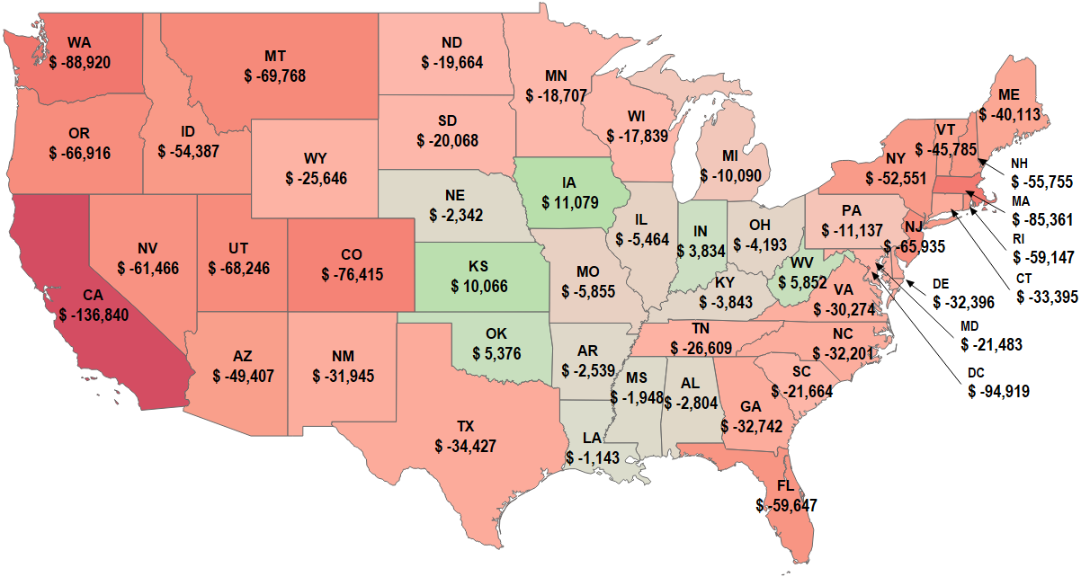
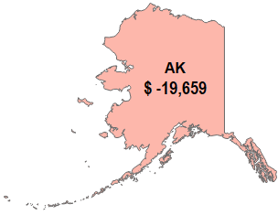


Housing Affordability Varies Considerably
Sources: Zillow, Tax -Rates.org, Wall Street Journal, Federal Housing Agency, US Census Bureau
Average Household Income Surplus or Deficit to Income Needed to Afford an Average Priced Home
Notes:
PowerPoint Charts/Maps/Home Affordability 1/27/23
No DOS codes

Slide 36
Still-Favorable Numbers
Source: US Census Bureau
Arizona Homeownership and Vacancy Rates
Raw Data: Percent
Notes:
W:\ITRDATA\PowerPoint Charts\Charts - State\Arizona\Arizona-Charts.xlsm Rental-Homeownership 3/27/2023

Slide 37
Post-Covid Market Correction
Source: FHFA
US Housing Price Index
Raw Data, Q1 1991 = 100
Risk: if the correction scares people instead of increasing housing affordability
Notes:
Charts from SQL\Raw Comp 6 SQL Charts USHPI Raw 3/29/2023
Purchase only (estimated using sales price data) housing price index for the United States, NSA. The FHFA House Price Index (HPI) is a broad measure of the movement of single-family house prices. The HPI is a weighted, repeat-sales index, meaning that it measures average price changes in repeat sales or refinancings on the same properties. This information is obtained by reviewing repeat mortgage transactions on single-family properties whose mortgages have been purchased or securitized by Fannie Mae or Freddie Mac since January 1975.

Slide 38
Market Adjusting in Arizona
Source: FHFA
US Arizona Housing Price Index
Raw Data: 1991 = 100
Notes:
W:\ITRDATA\PowerPoint Charts\Charts - State\Arizona\Arizona SQL Charts.xlsx AZHPINSA Raw 3/27/2023

Slide 39
This Lagging Segment Represents Opportunities
Source: US Census Bureau
US Private Nonresidential Construction to US Single-Unit Housing Starts
12/12 Rates-of-Change
Notes:
W:\ITRDATA\PowerPoint Charts\Charts - Reserve\Comps\CONNRES Comps NSQL CONNRES HS2FAM 3/23/2023

Slide 40
A Preferred Market Segment ~ Modest Growth Rate
Source: FRB
US Food Production Index
Annual Data Trends: 2017 = 100
3/12: | -0.7%
12/12: | 1.2%
Notes:
W:\ITRDATA\PowerPoint Charts\Charts from SQL\12MMA Comp\12MMA Comp 2 SQL Charts.xlsx FOODX 12MMA 3/17/2023

Slide 41
Seek Resistant Markets
Source: US Census Bureau
US Data Processing, Hosting and Related Services Revenue
Billions of Dollars
Notes:
W:ITRDATA\PowerPoint Charts/Charts from SQL/SOC MMT/SOC MMT 2 SQL Charts DPHRSR SOC 3/17/2023

Slide 42
US Macroeconomic Trends Summary
The consumer balance sheet is strong.
Determine if a Peloton effect is present
Play into the bifurcation of the economy
Seek additional talent
Corporate sector looks good.
Sales expressed in units will trend lower than nominal $ sales.

Slide 43

Brought to you by
People & Wages

Slide 44

Source: BLS
US to Arizona Unemployment Rates
Percentages
February 2023
AZ 3.2%
US 3.8%
Notes:
W:\ITRDATA\PowerPoint Charts\Charts - State\Arizona\Arizona-Charts.xlsm AZ Unemploy 3/27/2023
Annotates: USUERT AZUERT

Slide 45
Incredibly Low Numbers Persist
Source: BLS
Arizona to Yavapai Unemployment Rate
Raw Data: Percentages
Notes:
W:\ITRDATA\PowerPoint Charts\Charts - State\Arizona\Arizona SQL Charts.xlsx AZ Yavapai Unemployment Rate 3/27/2023

Slide 46
Job Openings Remain High But Are Decreasing
Source: BLS
US Total Nonfarm Job Openings
Data Trends: Millions of Job Openings
Concern: job openings drop below trend
Notes:
W:\ITRDATA\PowerPoint Charts\Charts - Reserve\Comps\EMPNFJO Comp NSQL.xlsx EMPNFJO DT 3/10/2023

Slide 47
Quit Rate is Coming Down: Expect That Trend to Continue
Source: BLS
US Nonfarm Quit Rate
Percent
Notes:
Charts from SQL\SOC MMA\SOC MMA 13 SQL Charts EMPNFQR SOC 3/13/2023

Slide 48
Wage Growth Has Likely Peaked For This Business Cycle
Source: Federal Reserve
Bank of Atlanta
US Full-Time Wage Growth
Percent
Notes:
W:\ITRDATA\PowerPoint Charts\Charts from SQL\Raw Comp\Raw Comp 4 NSQL Charts.xlsx EMPAFWGFT Raw 3/22/2023

Slide 49

The Positive Implications of Younger Workforces
Source: US Census Bureau
Available Workforce
Percent of Total Population
 | Gen Z | Millennials | Gen X | Boomers
US | 20.9% | 21.7% | 20.1% | 20.0%
AZ | 21.5% | 21.3% | 19.1% | 20.1%
Yavapai County | 15.2% | 14.4% | 16.9% | 33.6%
Notes:
W:\ITRDATA\PowerPoint Charts\Charts - State\Arizona\Multi-State Generation Calcs (multi) 2021 5-Year Estimates.xlsx 3/27/2023

Slide 50
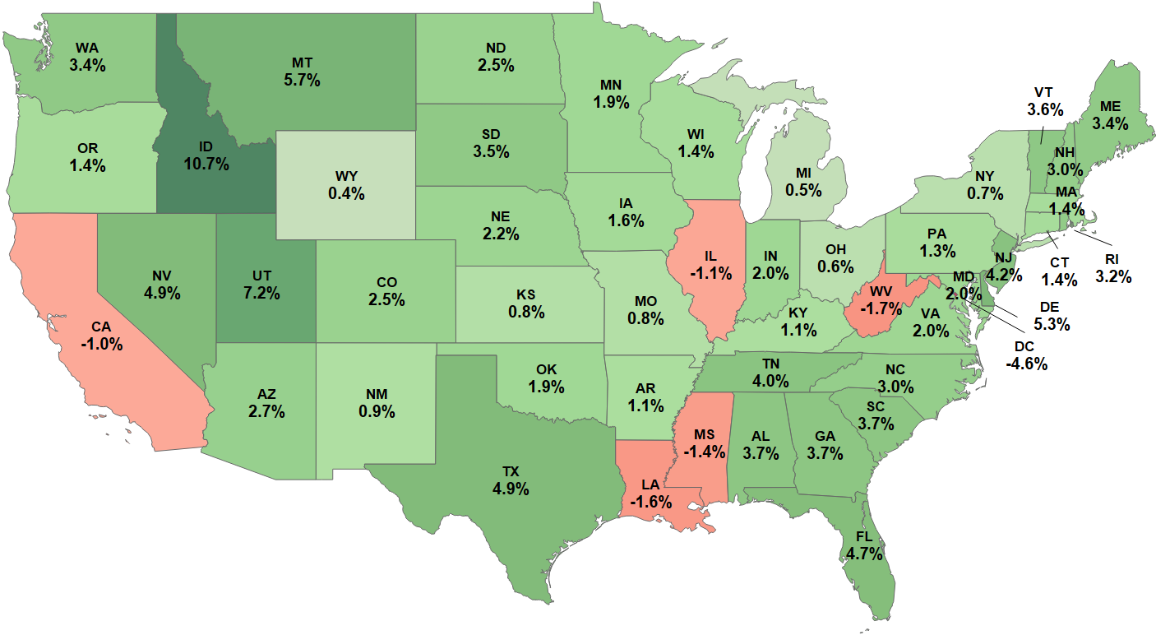
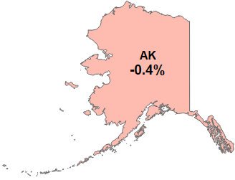


State Population Growth 2018 to 2022
Source: US Census Bureau
Population Growth 2018 – 2022, Percent Change
Notes:
W:\ITRDATA\PowerPoint Charts\Maps\State Population Growth Rates\2015-2019 State Population Growth.twb 48 States 3/14/23
Based on 1-year estimates

Slide 51
People Summary
There is a risk that wage inflation will not abate enough to satisfy the Fed.
There are going to be some layoffs in 2023-2024; grab some freed-up talent
Tougher times increases employee “stickiness” so moderate your own wage inflation
Seeing Job Openings decline below the long-term trend would be a concern.
Unemployment stays too low for the Fed’s comfort.

Slide 52

Brought to you by
Financial Market

Slide 53
Not Always 7%
Source: WSJ
S&P 500, Log Scale, 1920 – Present
Raw Data, Index: 1941-43 = 10
Notes:
W:\ITRDATA\Powerpoint Presentations\Company\ITR\ITR Webinars\2021\OPTIMIZER May 14 2021\MISC\S&P 500 from Eric P.xlsx Chart 1 3/9/23
This one updates correctly
Update on request

Slide 54
Downside Pressure Stemming from Monetary Policy
Sources: Wall Street Journal, FRB
US S&P 500 Stock Prices Index to M2 Money Supply (deflated)
Rates-of-Change
18
15
15
Notes:
W:ITRDATA/PowerPoint Charts/Charts from SQL/1-12 Comp/1-12 Comp 2 SQL Charts SP5 M2D 3/29/2023 New TITLE 3/22 BB

Slide 55
Stock Market Adversity is an Economic Risk
Sources: WSJ, Harvard US Leading
Indicator of Remodeling Activity
US S&P 500 Stock Prices Index to Harvard US Leading Indicator of Remodeling Activity
Raw Data
Risk: Burned through COVID $ and market is not supplying the wealth to keep on spending on large discretionary expenditures
Notes:
W:\ITRDATA\PowerPoint Charts\Charts from SQL\Raw Comp\Raw Comp 6 SQL Charts.xlsx SP5 LIRA 3/6/2023

Slide 56
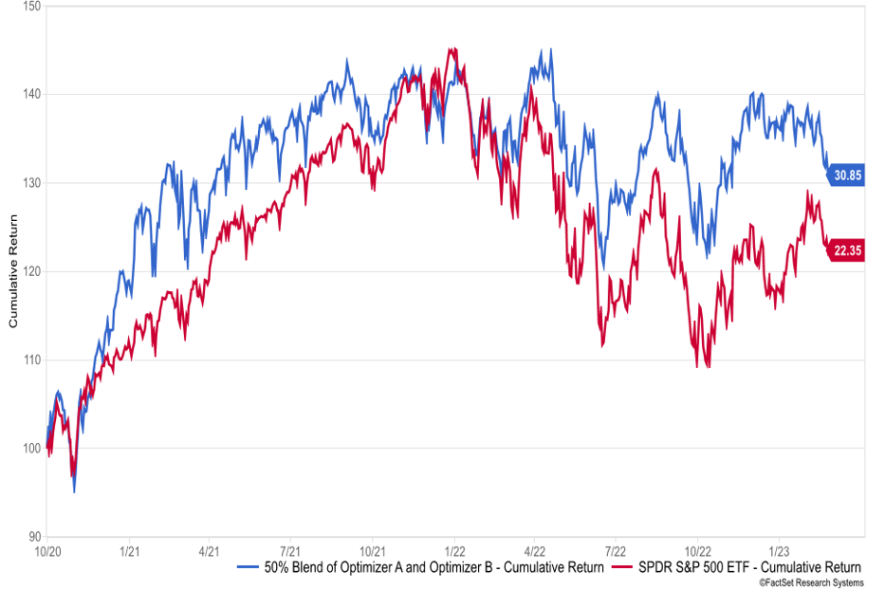
50/50 Blend Optimizer (50% A, 50% B)
Oct 1, 2020 through February 28, 2023
50/50 Blend Optimizer is made up of 50% Optimizer A, and 50% Optimizer B
brian@itreconomics.com to learn more
Notes:
3/2/23 BB

Slide 57
Financial Markets Summary
Stock market is going to experience greater-than-normal volatility.
Global weakness can lead to financial “shocks” that could worsen the 2023-2024 portion of this business cycle
General stock market seems unlikely to refill coffers in 2023.
National debt is more of a longer-term issue.

Slide 58
Disinflation and deflation will characterize 2023 and 2024 with an attendant easing of wage inflation.
The Fed’s actions gave rise to an inverse yield curve. Join us for Fed Watch to keep track of how this unfolds.
Expect a recession to begin in 2023 and most of 2024.
We expect the recession to be mild but that will not be true of every market.
Maximize competitive advantages to protect margins.
Assess cash needs; credit conditions are tightening.
Interest rates are likely to come down before they go further upward.
Think about expanding the asset classes you are invested in and how you invest in securities.
Notes:
March 24, 2023 per BB

Slide 59

Notes:
Jan 6, 2023

